Slide 1
Redes industriais
Redes Profibus
Aula12
Prof. Diovani Milhorim

Slide 2
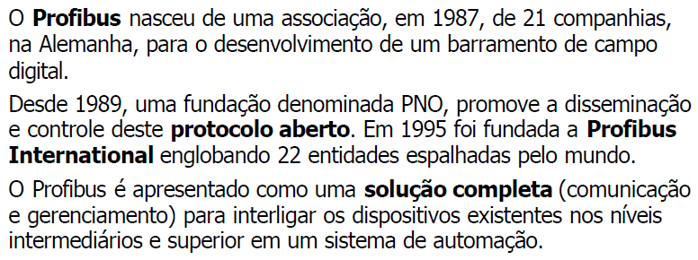
Redes Profibus

Slide 3
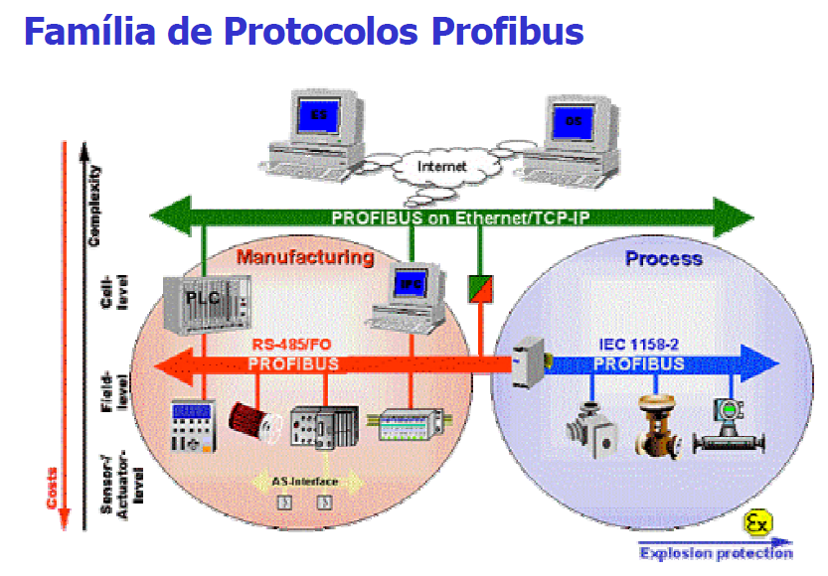
Redes Profibus

Slide 4
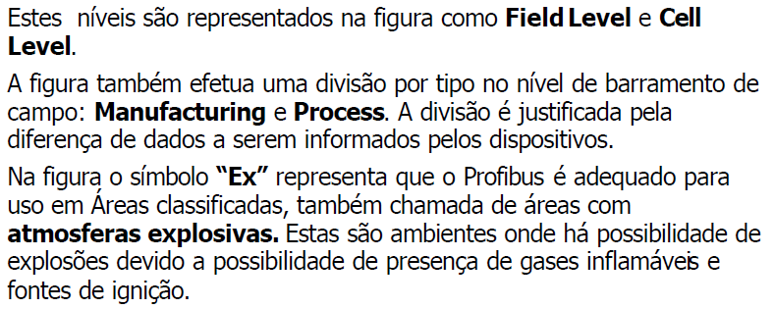
Redes Profibus

Slide 5
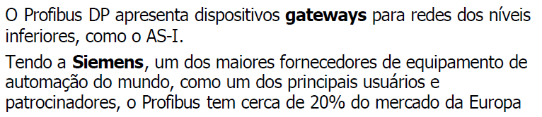
Redes Profibus

Slide 6
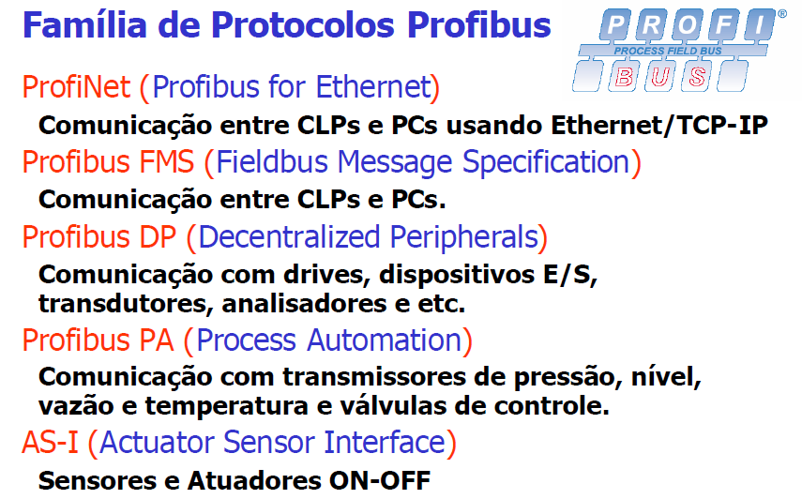
Redes Profibus

Slide 7
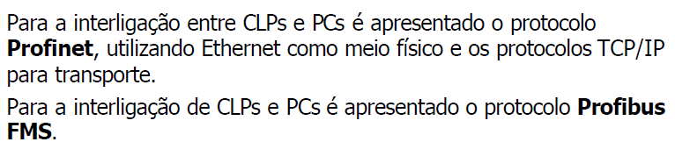
Redes Profibus

Slide 8
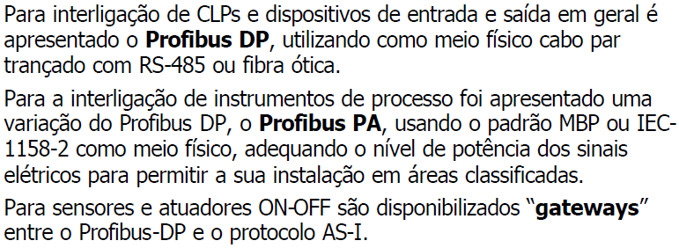
Redes Profibus

Slide 9
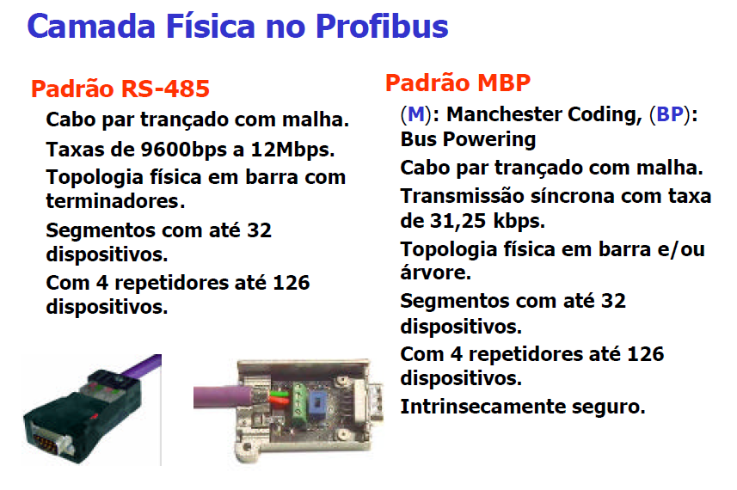
Redes Profibus

Slide 10
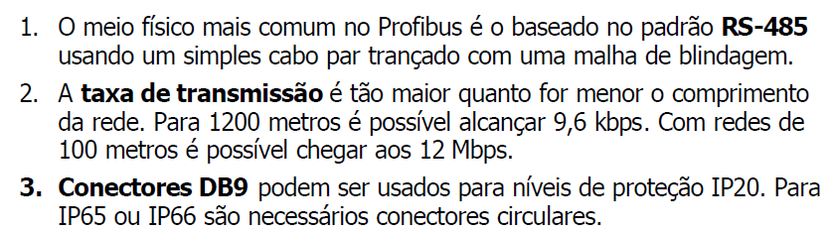
Redes Profibus

Slide 11
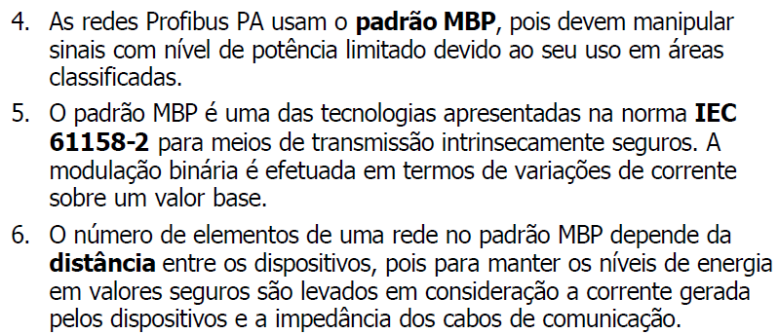
Redes Profibus

Slide 12
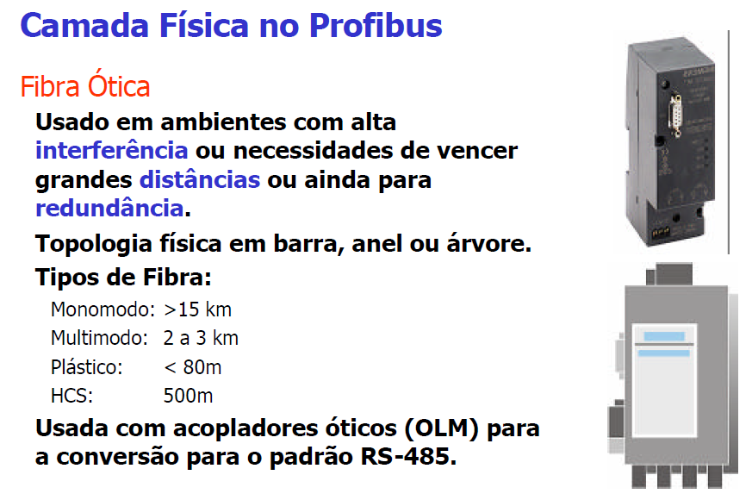
Redes Profibus

Slide 13
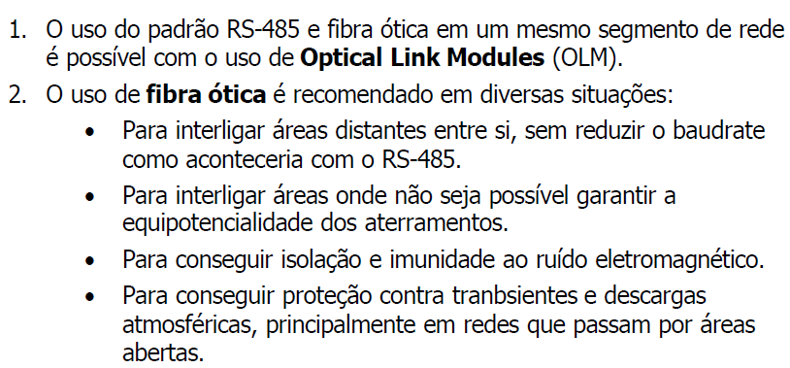
Redes Profibus

Slide 14
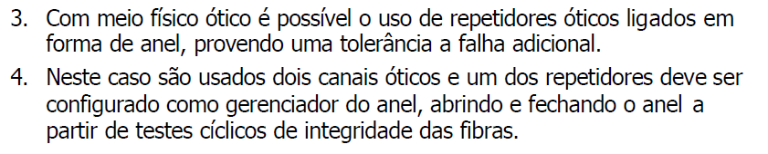
Redes Profibus

Slide 15
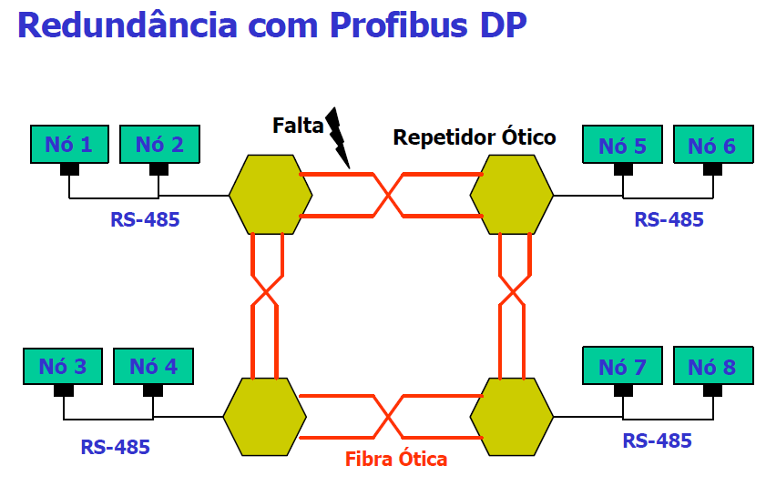
Redes Profibus

Slide 16
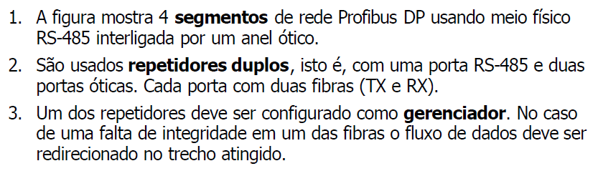
Redes Profibus

Slide 17
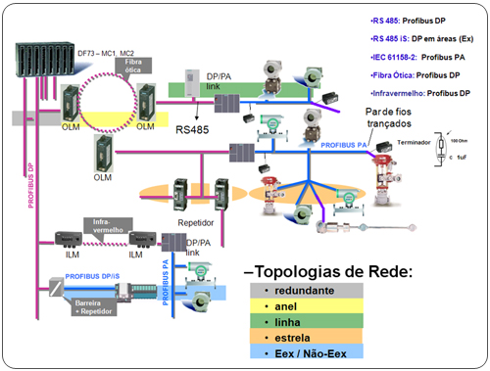
Redes Profibus
Exemplo de topologia mista:

Slide 18
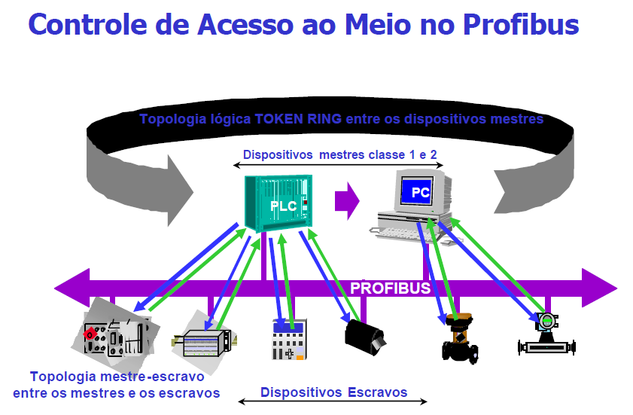
Redes Profibus

Slide 19
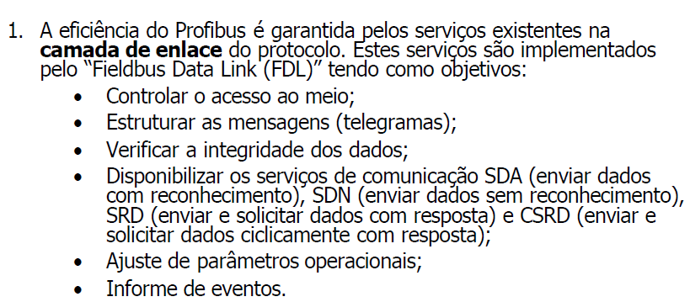
Redes Profibus

Slide 20
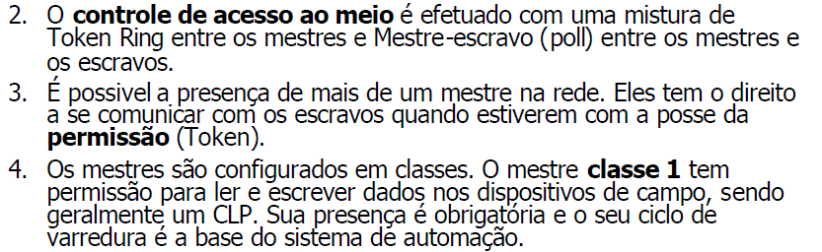
Redes Profibus

Slide 21
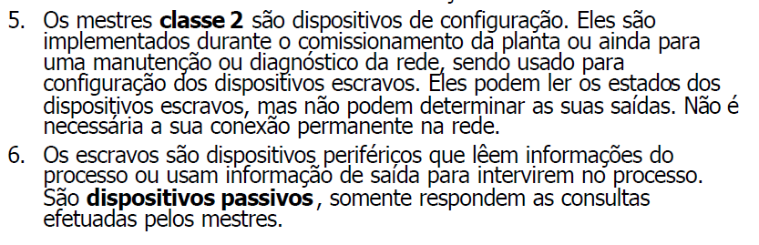
Redes Profibus

Slide 22
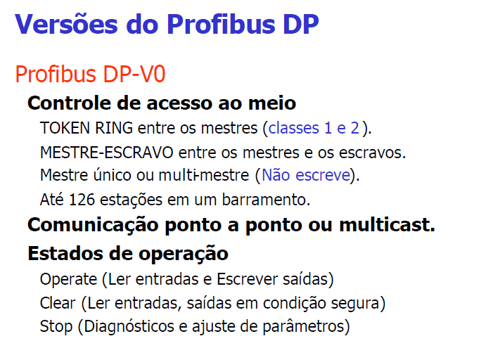
Redes Profibus

Slide 23
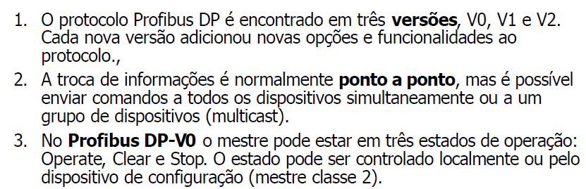
Redes Profibus

Slide 24
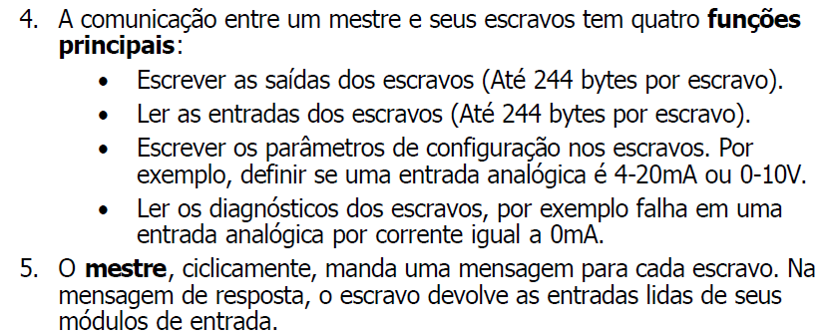
Redes Profibus

Slide 25
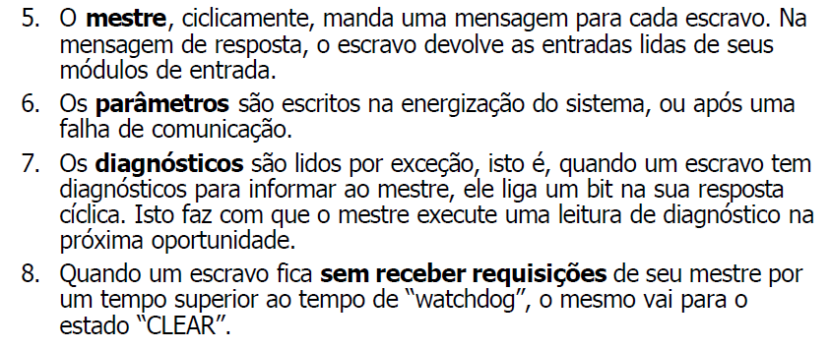
Redes Profibus

Slide 26
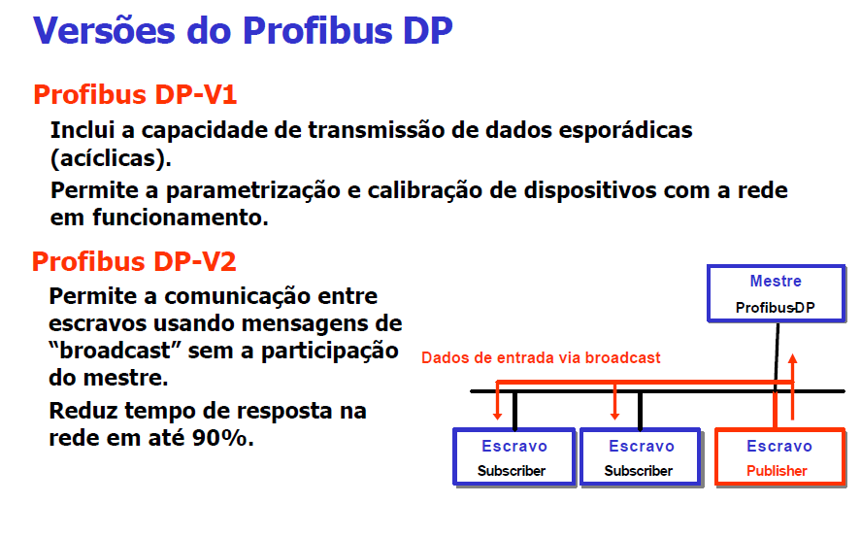
Redes Profibus

Slide 27
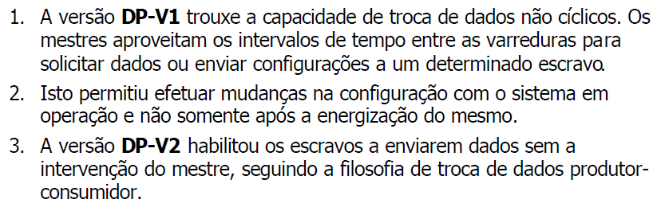
Redes Profibus

Slide 28
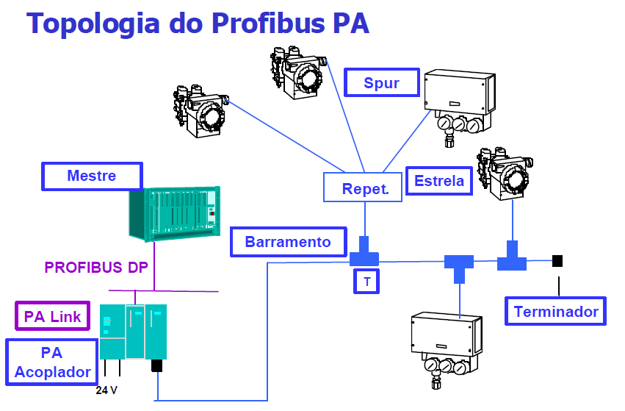
Redes Profibus

Slide 29
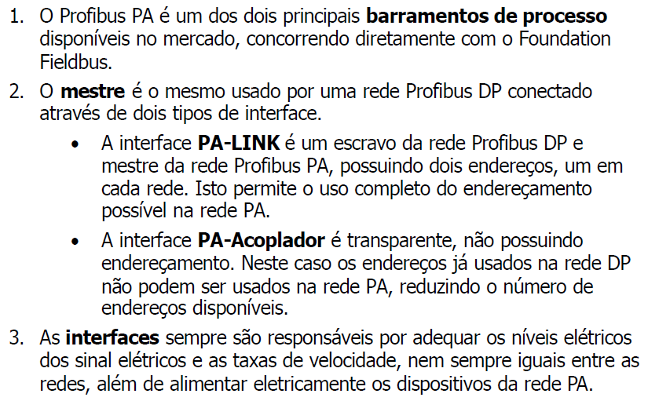
Redes Profibus

Slide 30
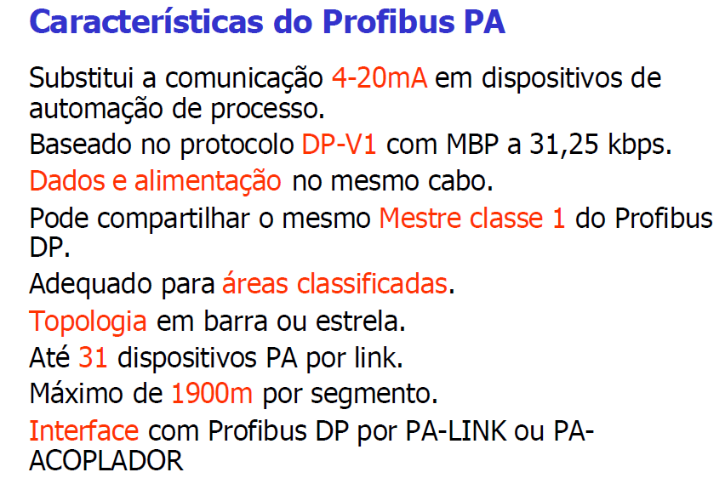
Redes Profibus

Slide 31
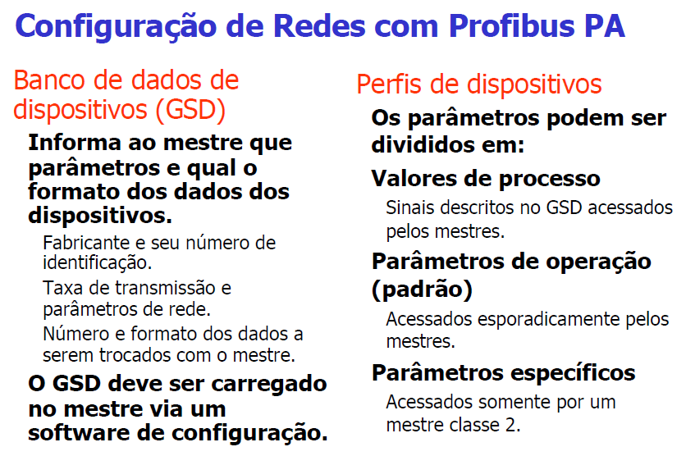
Redes Profibus

Slide 32
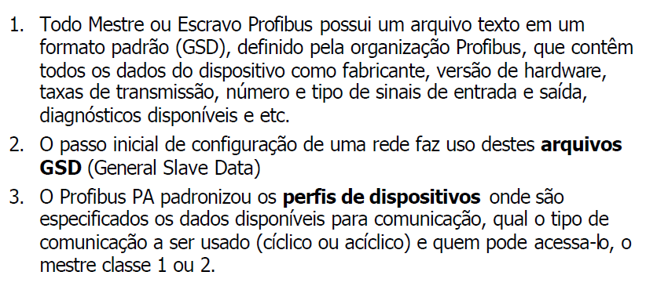
Redes Profibus

Slide 33
Redes Profibus
MaxTsdr_31.25 = 100
MaxTsdr_45.45 = 250
MaxTsdr_93.75 = 1000
MaxTsdr_187.5 = 1000
Redundancy = 0
Repeater_Ctrl_Sig= 0
24V_Pins = 0
Freeze_Mode_supp = 0
Sync_Mode_supp = 0
Auto_Baud_supp = 0
Set_Slave_Add_supp = 1
Min_Slave_Intervall = 250
Modular_Station = 1
Max_Module = 2
Max_Input_Len = 10
Max_Output_Len = 2
Max_Data_Len = 12
Max_Diag_Data_Len = 14
Slave_Family = 12
User_Prm_Data_Len = 0
;Ext_User_Prm_Data_Const(0) = 0x00,0x00,0x00
;Modules for Analog Input
Module = "Analog Input (short) " 0x94
EndModule
Module = "Analog Input (long) " 0x42, 0x84, 0x08, 0x05
EndModule
;Module for Totalizer
Module = "Total " 0x41, 0x84, 0x85
EndModule
Module = "Total_Settot " 0xC1, 0x80, 0x84, 0x85
EndModule
Module = "Total_Settot_Modetot " 0xC1, 0x81, 0x84, 0x85
EndModule
;Empty module
Module = "EMPTY_MODULE“ 0x00
EndModule
;***********************************************************
;** GSD file for LD303 - Pressure Transmitter **
;** **
;** Manufacture : SMAR **
;** **
;** Stand: 01.13.2000 Revised by: MG. **
;** smar0895.GSD **
;***********************************************************
;
#Profibus_DP
GSD_Revision = 2
Vendor_Name = "SMAR"
Model_Name = "LD303 SMAR"
Revision = "1.0"
Ident_Number = 0x0895 ; 0x9740
Protocol_Ident = 0
Station_Type = 0
Bitmap_Device = "Src0895n"
FMS_supp = 0
Hardware_Release= "3.0"
Software_Release= "1.19"
31.25_supp = 1
45.45_supp = 1
93.75_supp = 1
187.5_supp = 1

Slide 34
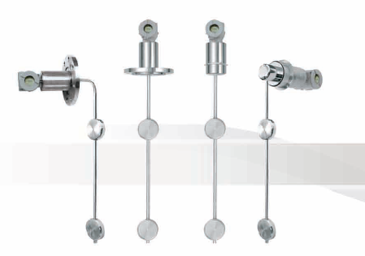
Redes Profibus
Transmissor de densidade – DT300 - SMAR

Slide 35
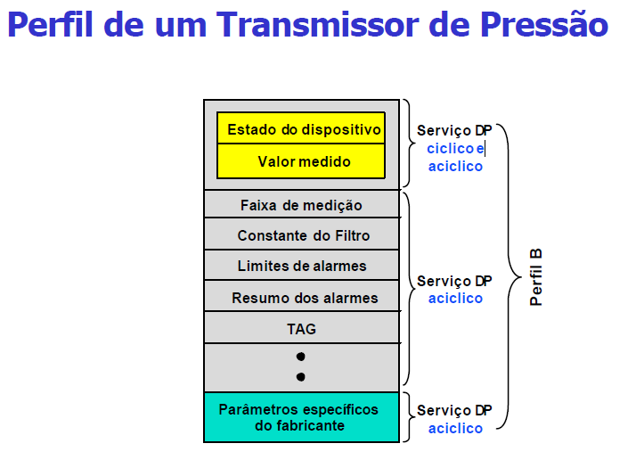
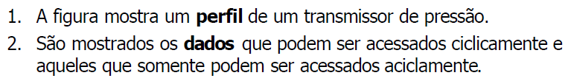
Redes Profibus

Slide 36
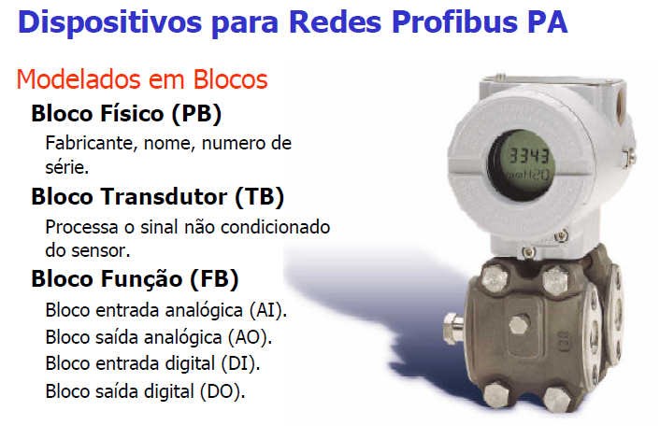
Redes Profibus

Slide 37
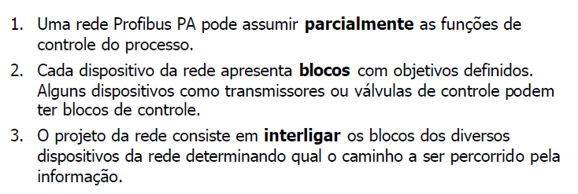
Redes Profibus

Slide 38
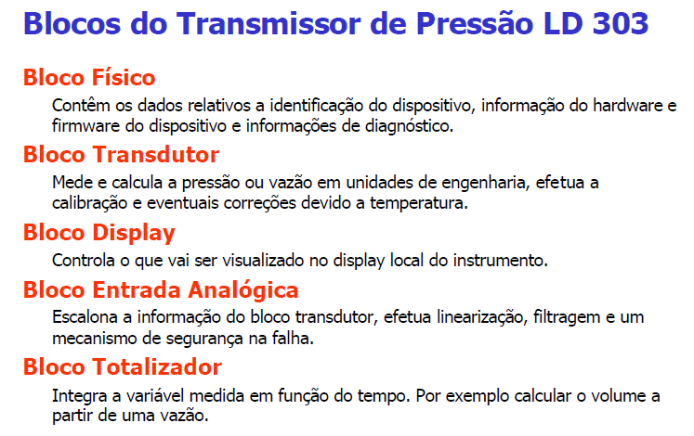
Redes Profibus

Slide 39
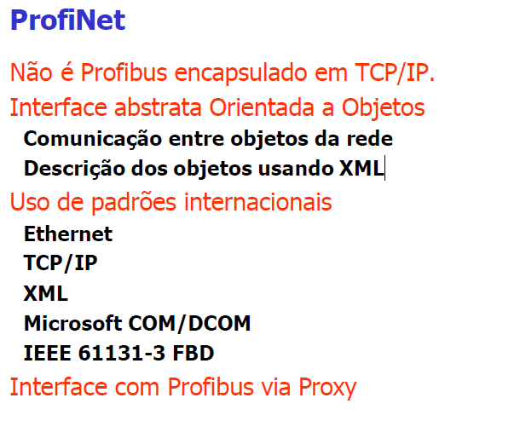
Redes Profibus

Slide 40
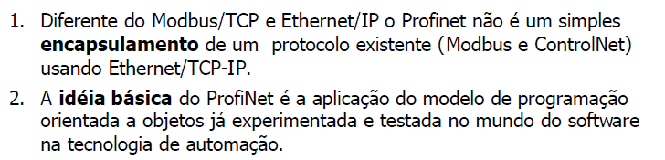
Redes Profibus

Slide 41
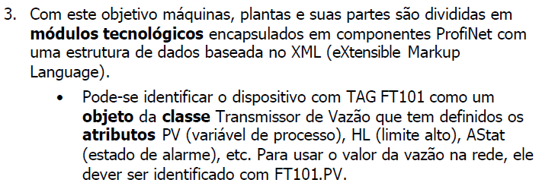
Redes Profibus

Slide 42
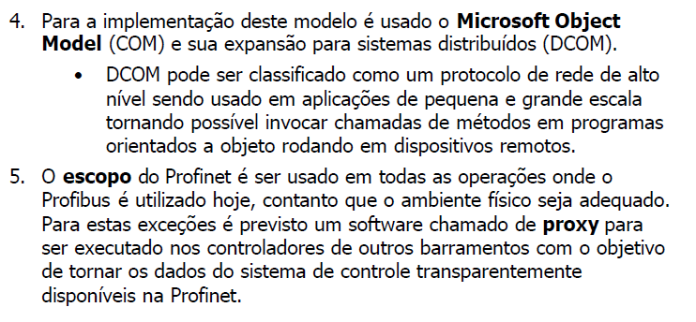
Redes Profibus

